Slide 1

Module 10: Genome assembly
Eugene Gardner
Postdoctoral Fellow, Wellcome Sanger Institute
e : eg15@sanger.ac.uk
: @DrGeneUK
Presentation originally developed by:
Shane McCarthy

Slide 2
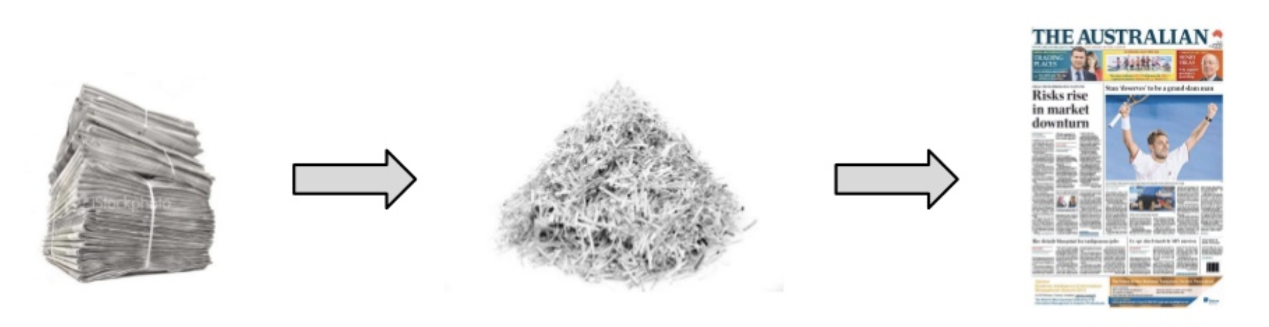
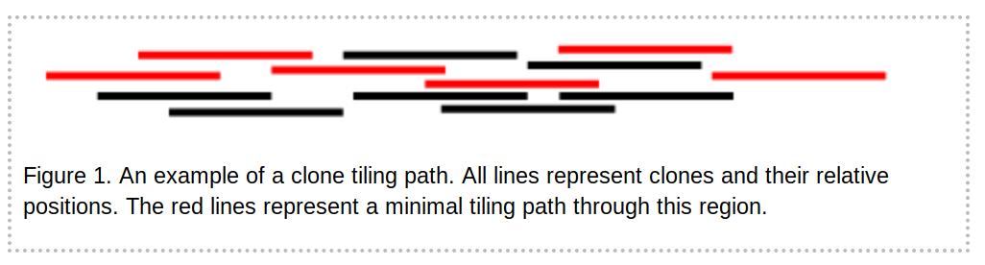
What is genome assembly?
The process of reconstructing the genomic sequence from sequenced fragments
Sequencing technologies can only sequence short stretches of DNA (100 bp-1M bp)
Given many (millions or billions) of reads, produce a linear (or perhaps circular) genome
Clone based
Select clones using markers
Sequence clones separately
Whole-genome shotgun
Fragment whole-genome into tiny pieces and sequence

Slide 3
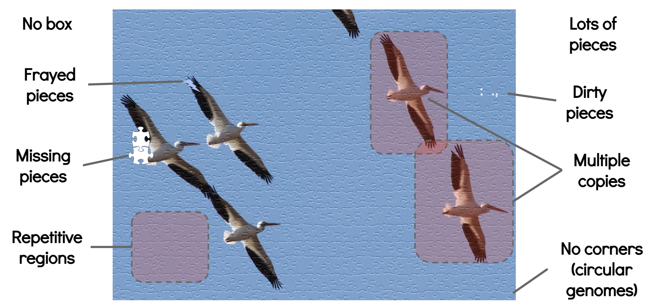
What makes assembling a jigsaw puzzle hard?
What helps? Larger pieces (longer reads); fewer dirty or frayed pieces (more accurate reads); fewer repeats and copies (simpler genomes)

Slide 4
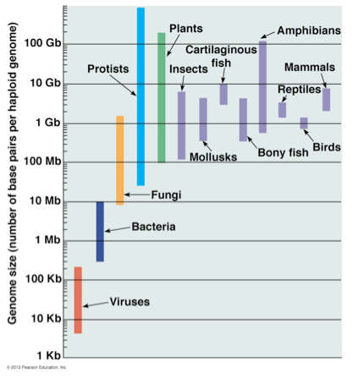
Key considerations in assembly
genome size
genome heterozygosity and ploidy
sequencing coverage
errors in reads
read lengths
non-uniqueness of the genome (repeat content)
running time and memory of assembly strategy

Slide 5
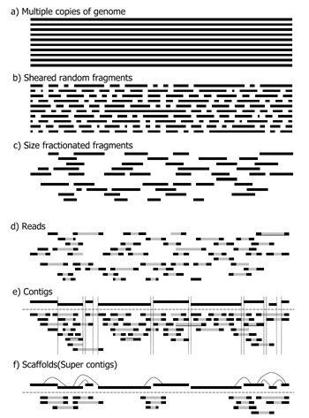
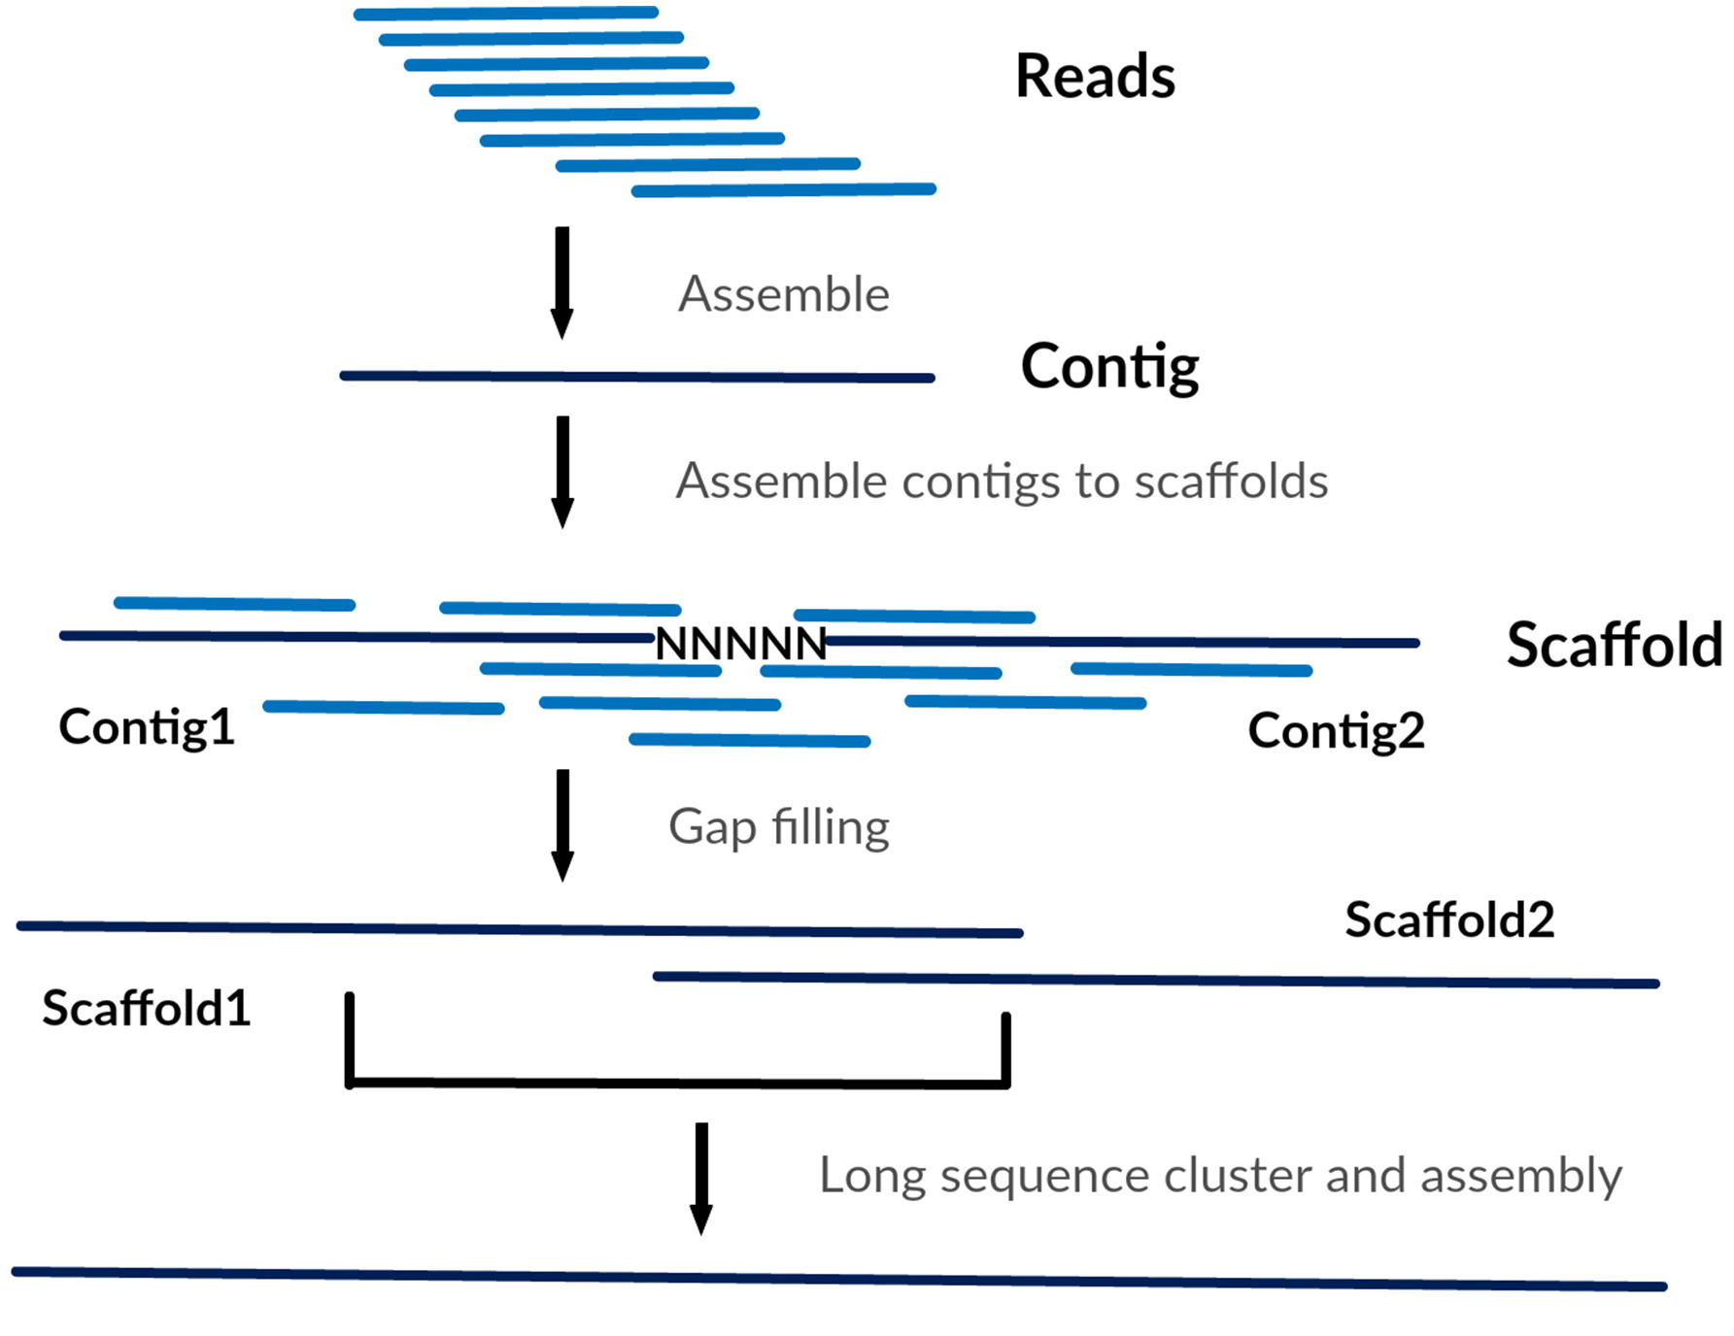
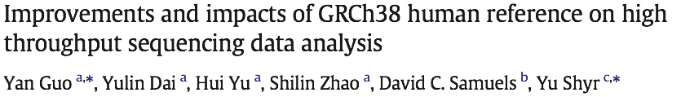
Terminology
Puzzle pieces
Partial Puzzle
Full Puzzle
Chromosome
contig: contiguous stretch of assembled sequence
scaffold: ordered set of contigs with gaps (Ns) placed between

Slide 6
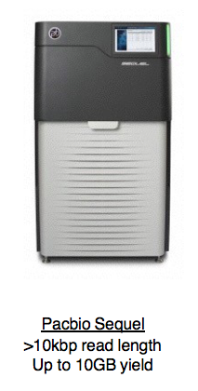
Brief History of Genome Assembly Technology
DNA
DNA Fragment
Fragment
Sequence
DNA Fragment
DNA Fragment
Sequence
Sequence
Sequence
DNA Fragment
Bacterial Artificial Chrom.
Flow Cell
Sanger/Capillary Sequencing
Shotgun Sequencing
Short-Read (Illumina) Sequencing
Long-Read (Pacbio/ONT) Sequencing

Slide 7
Brief History of Genome Assembly Technology
DNA
DNA Fragment
Fragment
Sequence
DNA Fragment
DNA Fragment
Sequencing!
Sequence
Sequence
Sequence
DNA Fragment
Bacterial Artificial Chrom.
Flow Cell
Sanger/Capillary Sequencing
Shotgun Sequencing
Short-Read (Illumina) Sequencing
Long-Read (Pacbio/ONT) Sequencing

Slide 8
Brief History of Genome Assembly Technology
DNA
DNA Fragment
Fragment
Sequence
DNA Fragment
DNA Fragment
Sequencing!
Parallelization (More Reads)!
Sequence
Sequence
Sequence
DNA Fragment
Bacterial Artificial Chrom.
Flow Cell
Sanger/Capillary Sequencing
Shotgun Sequencing
Short-Read (Illumina) Sequencing
Long-Read (Pacbio/ONT) Sequencing

Slide 9
Brief History of Genome Assembly Technology
DNA
DNA Fragment
Fragment
Sequence
DNA Fragment
DNA Fragment
Sequencing!
Parallelization (More Reads)!
Read Length!
Sequence
Sequence
Sequence
DNA Fragment
Bacterial Artificial Chrom.
Flow Cell
Sanger/Capillary Sequencing
Shotgun Sequencing
Short-Read (Illumina) Sequencing
Long-Read (Pacbio/ONT) Sequencing

Slide 10
Brief History of Genome Assembly

Slide 11
Key considerations in assembly – Technology
Long read sequencing has become the dominant platform for genome assembly
Illumina reads alone are rarely used now - while there used to be a large tradeoff in length/error rate of reads, improvements in tech and algorithms have made long reads common.

Slide 12
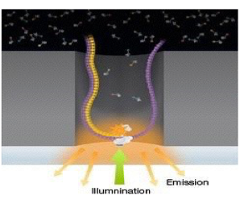
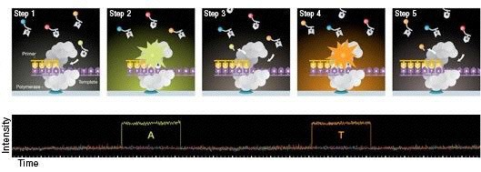
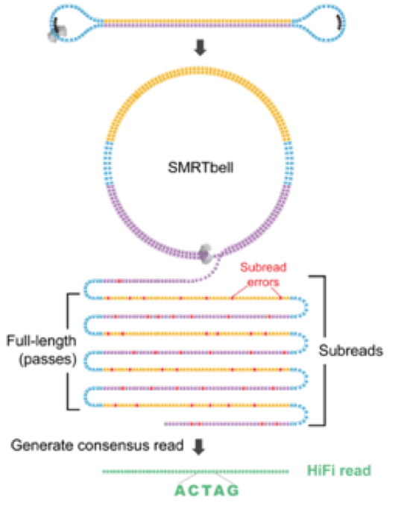
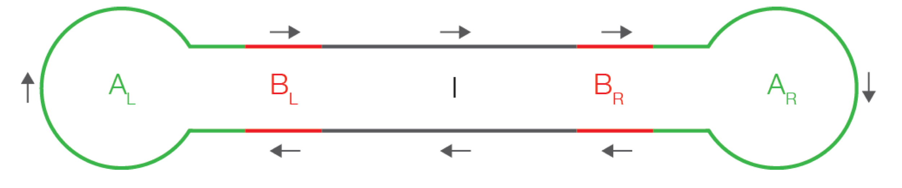
PacBio sequencing
Key points:
1 DNA molecule and 1 polymerase in each well (zero-mode waveguide, ZMW)
4 colours flash in realtime as polymerase acts
Methylated bases have distinct pattern
No theoretical limit to DNA fragment length
Slides from Ira Hall, via Jared Simpson

Slide 13
PacBio sequencing and assembly
Advantages:
Long read lengths
Few systematic errors
Can detect some base modifications
Can get more accuracy, if you loop over the ZMW multiple times - circular consensus sequencing (CCS)
Disadvantages:
High read error rate
High cost per-base
2019 Update:
Sequel II launched with 8-fold increase in yield and improvement in CCS accuracy (HiFi reads).
Slides from Ira Hall, via Jared Simpson

Slide 14
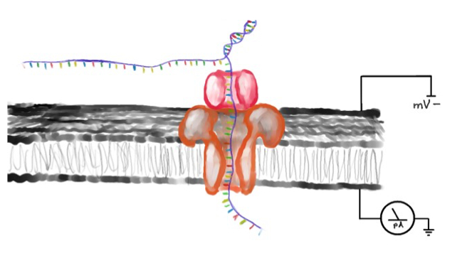
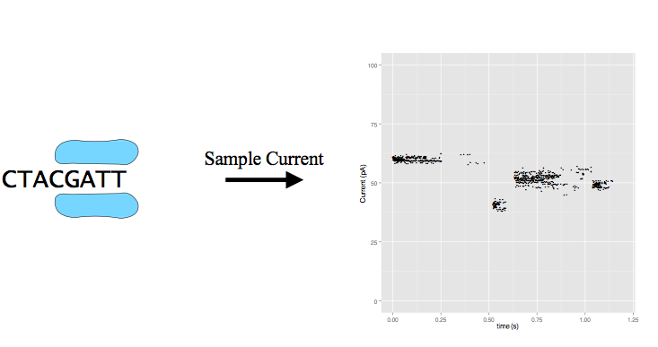
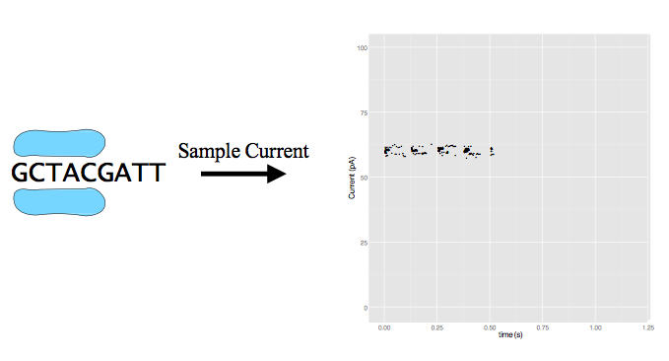
Nanopore sequencing
Illustration by David Eccles
Notes:
Nanopore sequencing relies on pore proteins embedded in a membrane with an electrical gradient across it.
DNA strands are split and a single strand at a time is passed through the pore using a molecular motor. DNA passes through at 250 basepairs per second (ONT R9 pore)
As the DNA passes through, it disrupts the electrical gradient across the pore.
The disruptions in this gradient can be mapped to DNA sequences (usually 5 to 6 mers). A recurrent neural network is used to associate a disruption state to a specific kmer.
Nanopores are used to sequence both DNA and RNA, and work is being done to make the technology suitable for routine protein sequencing.

Slide 15
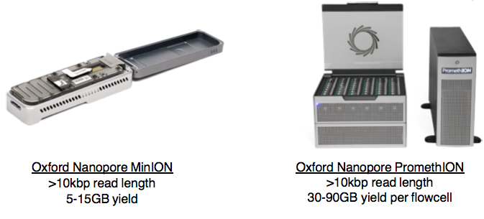
Nanopore sequencing and assembly
Ed Yong. The Atlantic. September 16, 2015.
Advantages:
Portability and low capital cost
Read lengths up to 1Mbp reported
Base modification detection
Sequence RNA directly
Disadvantages:
High error rate
Systematic errors around homopolymers
Slides from Ira Hall, via Jared Simpson

Slide 16
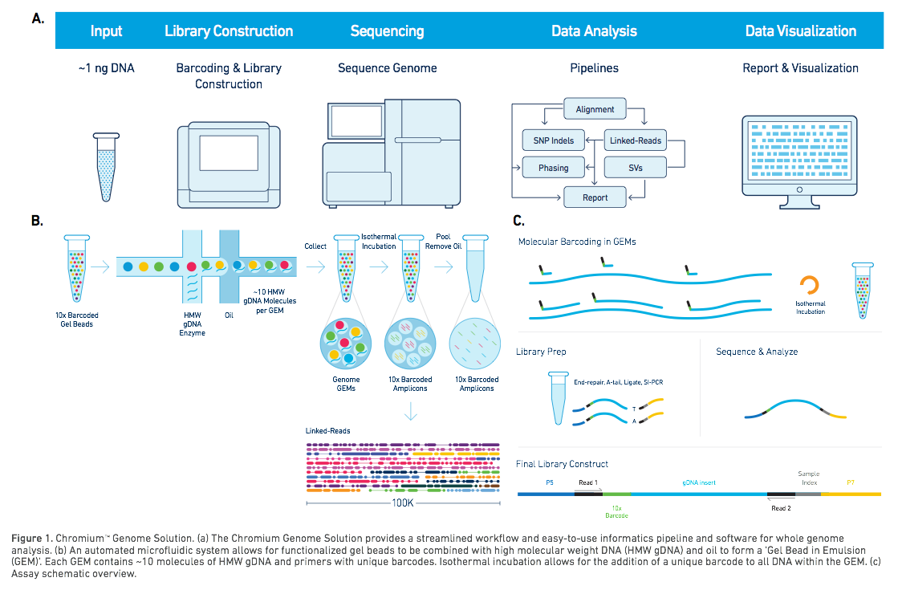

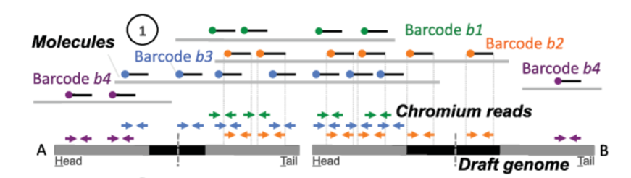
Read clouds or linked-reads
Longer range “read clouds” e.g. from 10X Genomics Chromium, can bridge bigger repeats/gaps
Multiple reads from a long ~100kb template sharing a barcode
Yeo S, Coombe L, Warren RL, Chu J, Birol I. ARCS: scaffolding genome drafts with linked reads. Bioinformatics. 2018.
Notes:
Long, high-molecular weight DNA pieces are placed individually into droplets.
Each droplet undergoes a short-read sequencing reaction. Within each droplet, each read is labeled with a 10x barcode.
The barcodes are then used to phase SNVs, indels and structural variants.

Slide 17
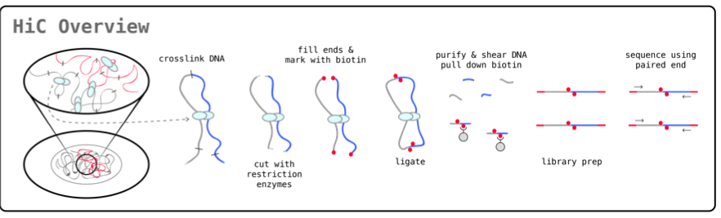
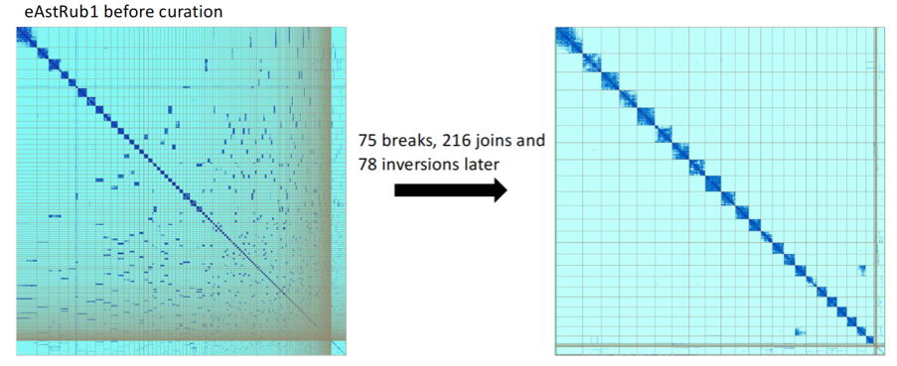
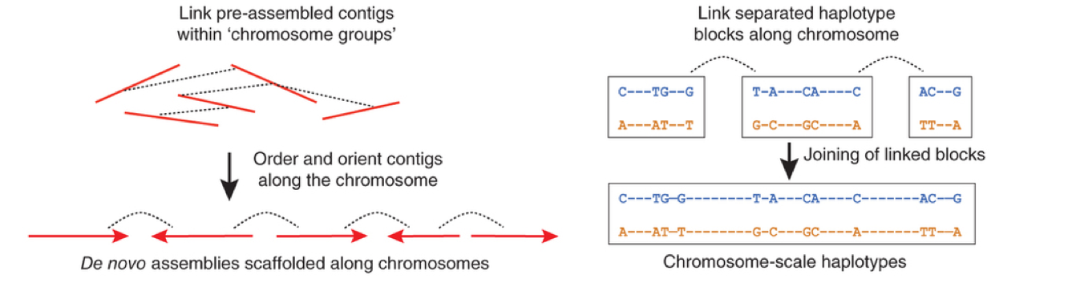
Hi-C
Hi-C “proximity ligation”
is used to look at local chromatin organisation, but globally most Hi-C links are on the same chromosome, and more are close than distant
Automated tools (e.g. SALSA2, 3d-dna)
Visualisers (e.g. Juicer, Hi-Glass)
Editors (e.g. Juicer, Pretext)
Notes:
Hi-C provides long-range chromatin organization information - helps answer “which pieces of the chromatin are near each other”
In Hi-C, DNA is crosslinked and cut with restriction enzymes.
Ends are filled with biotin, which is then ligated.
The crosslinking is then reversed and the ligated DNA portions are sequenced, revealing the sequences on either side of the restriction site.

Slide 18
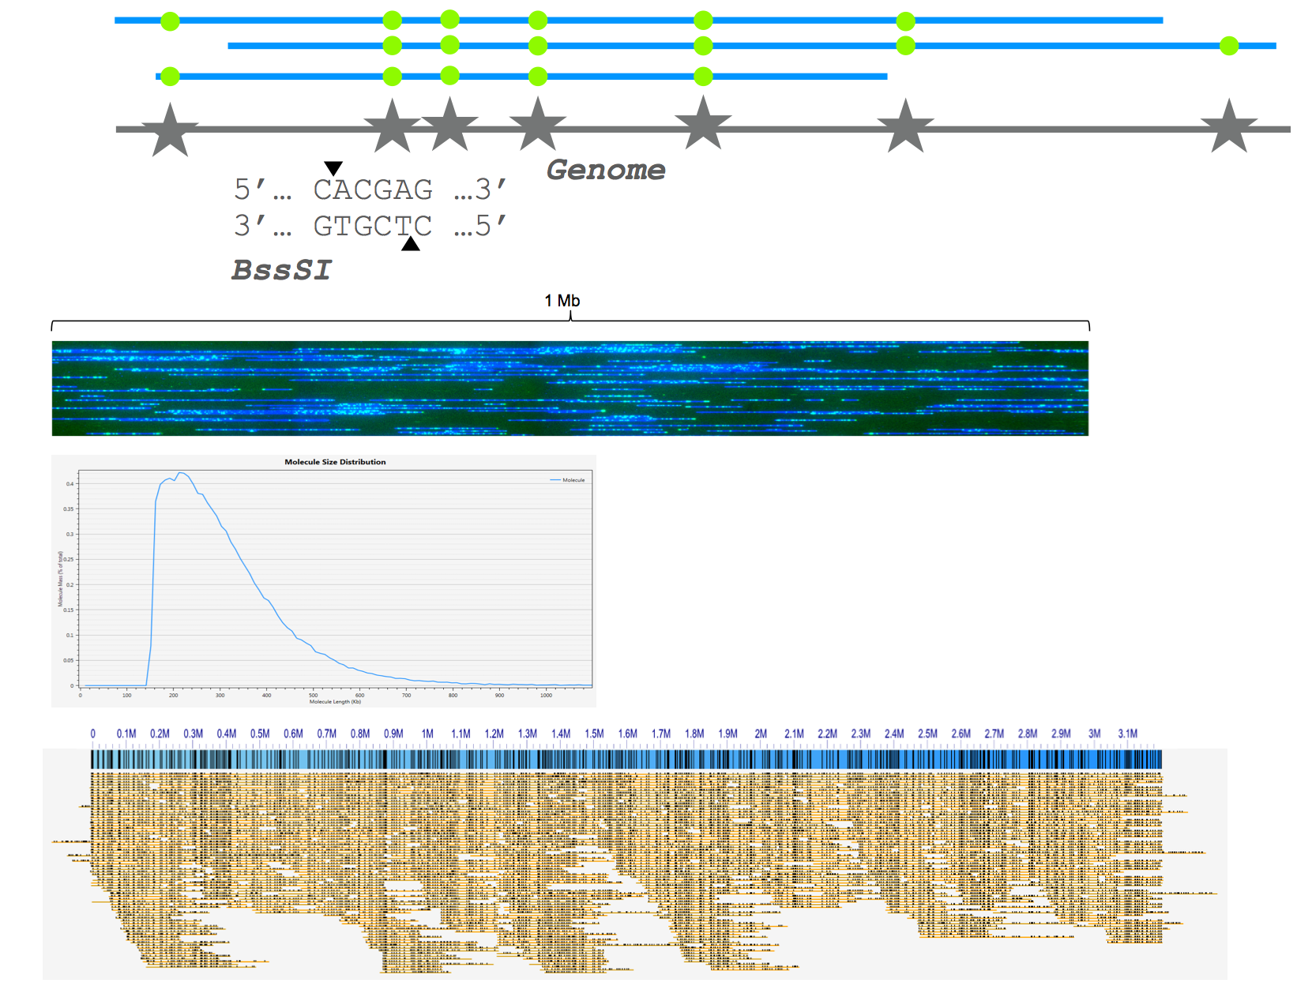
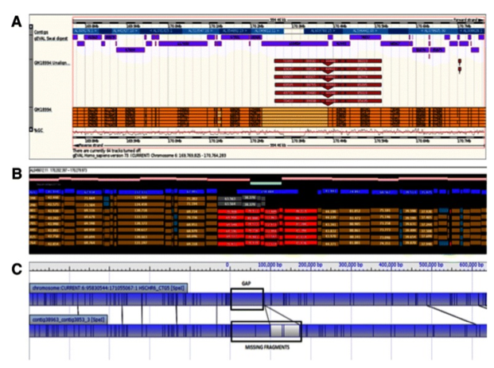

Optical mapping
Isolate high molecular weight DNA fragments
Label specific sequence motifs across the entire genome
Linearise and image labelled DNA
Restriction digest maps give approximate spacing of restriction sites (short sequence motifs), skipping over repeats
Now scaled up by dedicated optical imaging machines, e.g. BioNano
Notes:
Much like Fiber-FISH (used for SV detection)
Provides very long range information based on probes.

Slide 19
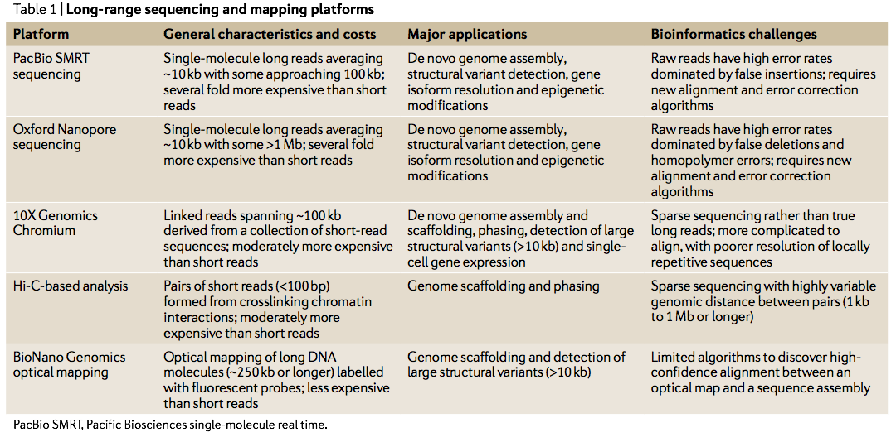
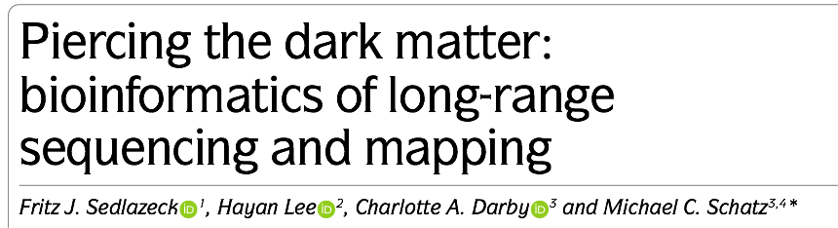
Long-range technologies

Slide 20
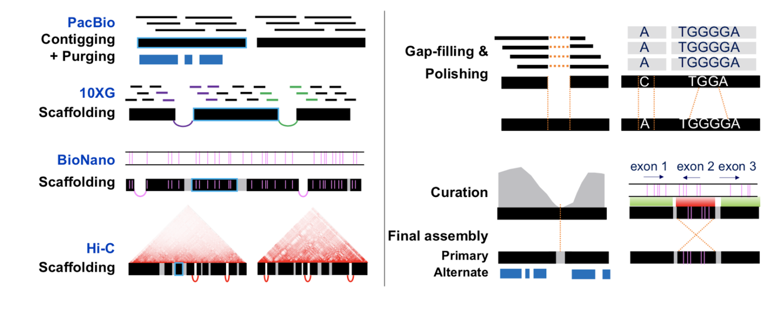
Example genome project workflow
Vertebrate Genomes Project

Slide 21
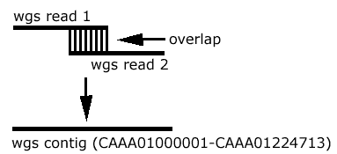
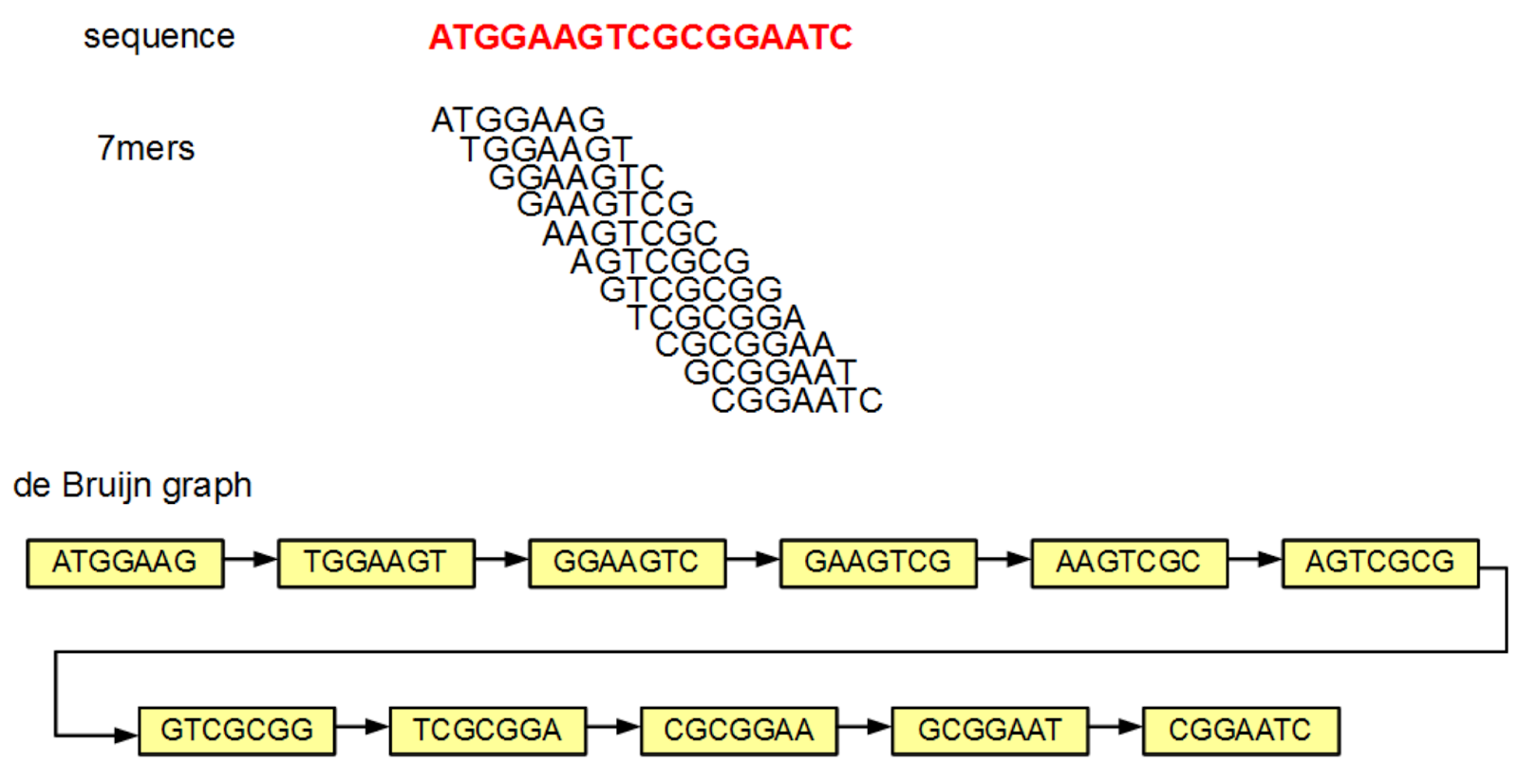
Assembly: contig generation
OLC (Overlap Layout Consensus):
For all pairs x, y, of reads
determine if there is sufficient overlap
bundle stretches of overlap graph into contigs
Computationally expensive (quadratic scaling with current approaches)
Assembly software
Falcon (PacBio), Canu (PacBio, ONT), minimap/miniasm
DBG: de Bruijn graph (k-mer):
Build a graph of all subsequences (“kmers”) of length k.
Assembly software
velvet, ABySS, SPAdes, wtdbg2
Notes:
How do we generate contigs?
Two main types of assembly algorithms

Slide 22
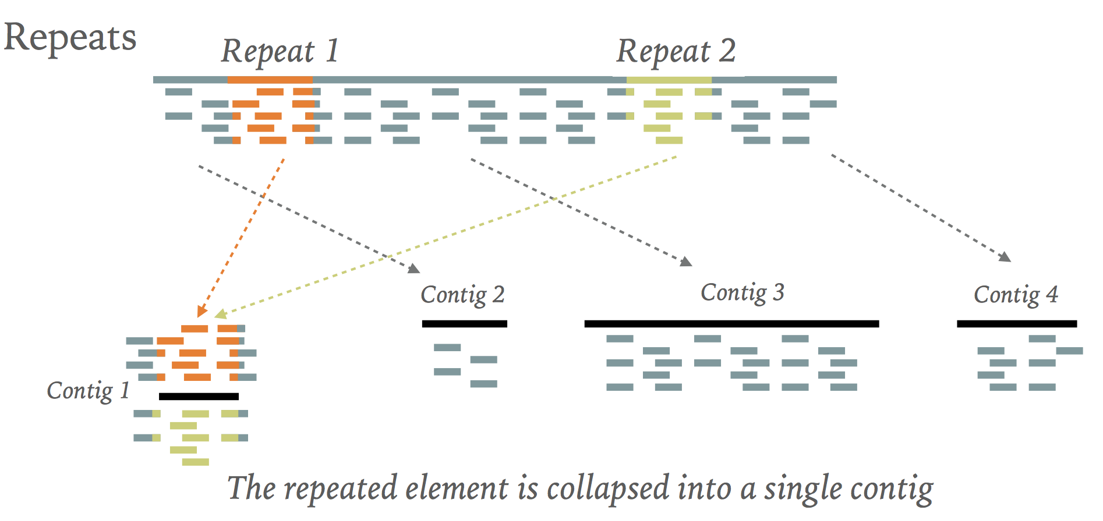
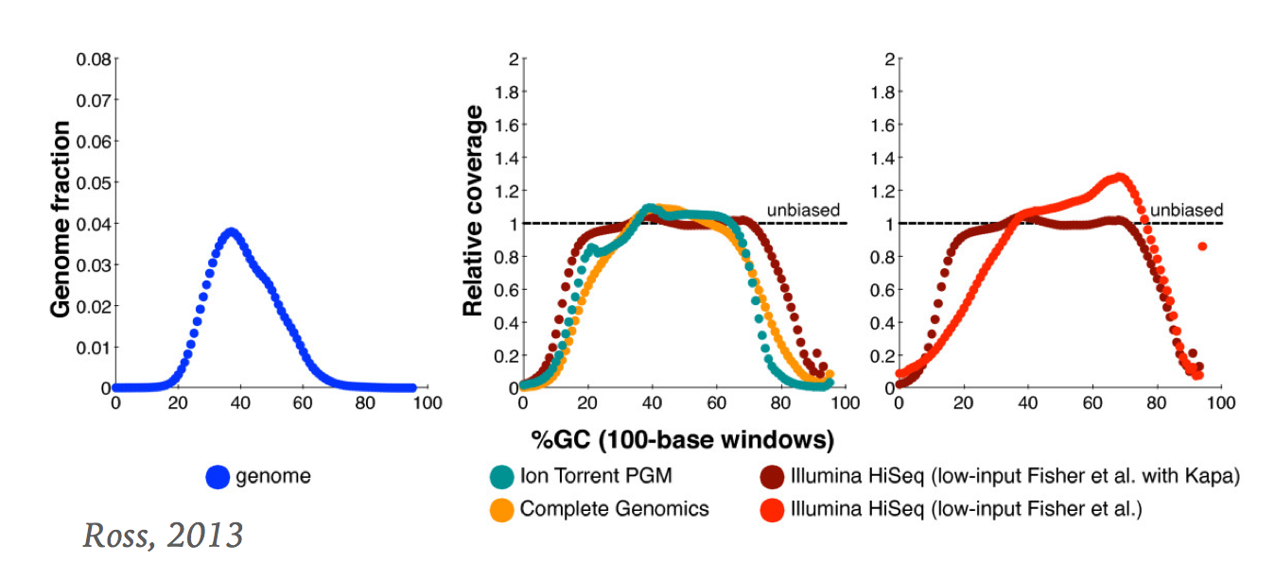
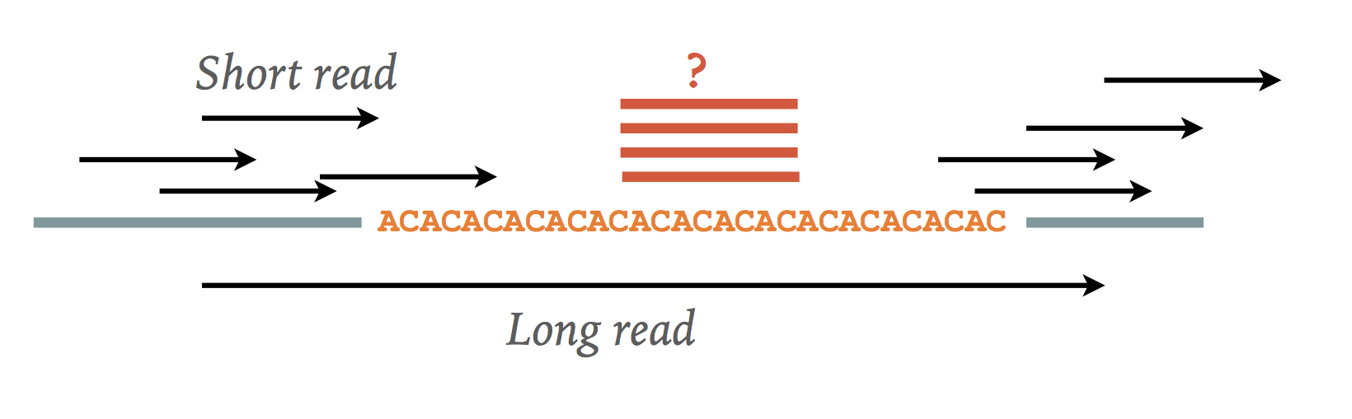
Hurdles
Repeats / low complexity genomic regions
Heterozygosity
Sequencing errors
Base composition and sequencing bias

Slide 23
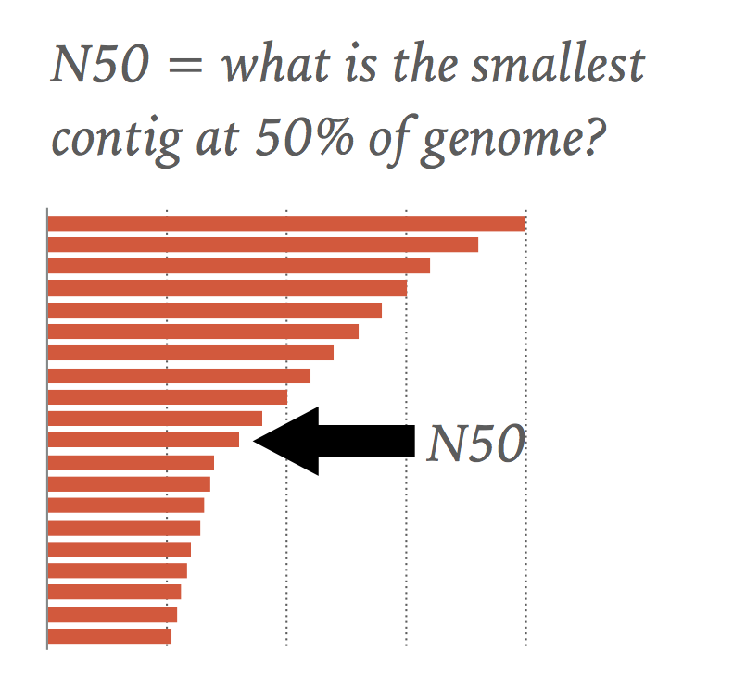
Assembly metrics
total length
number of sequences (contigs and scaffolds)
average length (contigs and scaffolds)
largest/smallest (contigs and scaffolds)
N50 = X means 50% of the genome is in sequences larger than X
NG50 (N50 scaled by the expected genome size)
Gene content (% conserved core genes mapped)

Slide 24
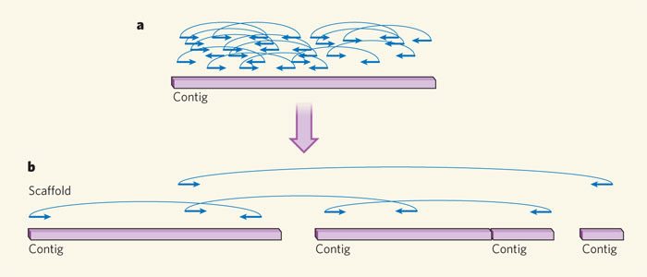
Scaffolding
Goal: Order and orient the contigs into larger structure
Construct libraries of varying insert sizes
Smaller size (2, 4 or 6 Kb), intermediate size (10-40 Kb), and libraries with large insert sequences (>100 Kb)
Ends of these clones are sequenced, generating sequence reads.
Sources of evidence
Mate-pair illumina libraries
Fosmid ends
Bacterial artificial chromosomes
10x Genomics linked reads
Hi-C
Optical maps
Gaps consisting of N (unknown) bases are inserted between contigs

Slide 25
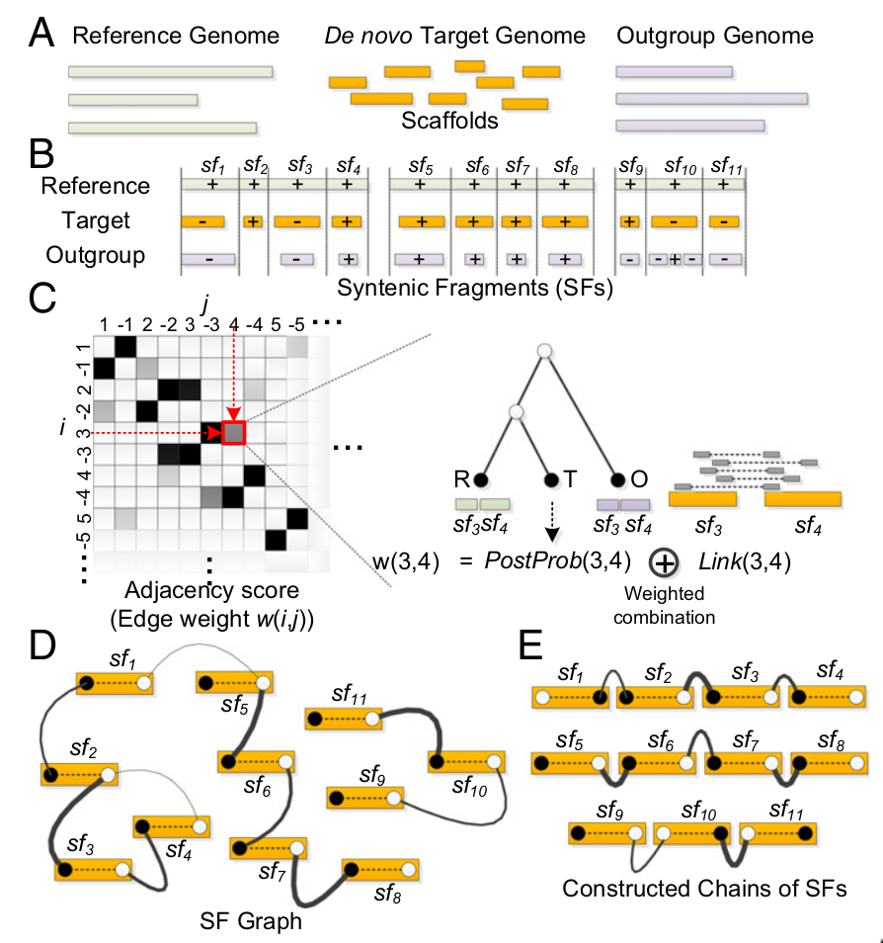
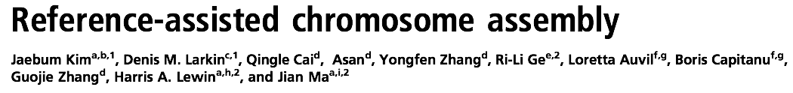
(Pseudo) chromosome assignment
Goal: Assembly of chromosome-scale DNA fragments from scaffolds
Sources of evidence
A close reference genome and/or outgroup genome
Genetic markers or map
RACA software
Input: Reference genome, de novo assembly, and one or more outgroups (A)
Identify syntenic fragments (B)
Calculate likelihood of adjacencies (C)
Notes:
Ordering the scaffolds (which are themselves ordered / connected contigs) into even longer structures.

Slide 26
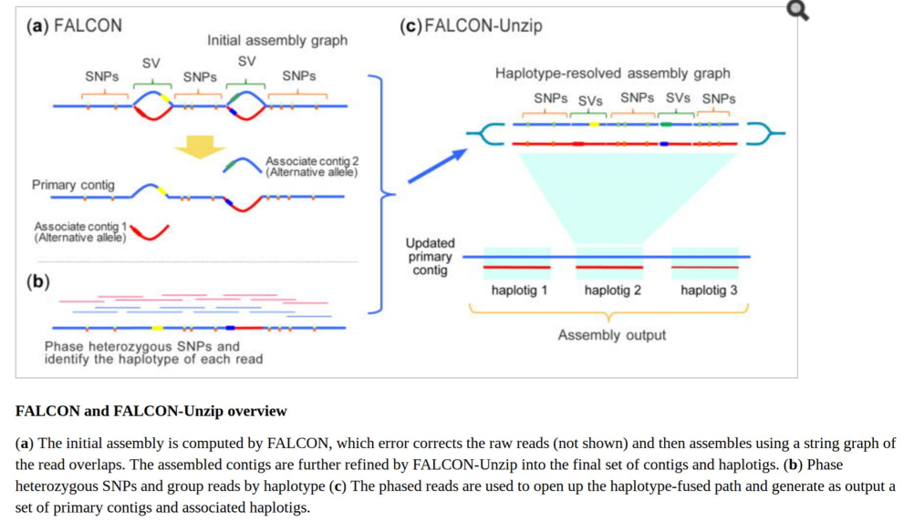
Diploid assembly
Almost all assemblers assume genome is haploid
Ignore allelic variation between parental chromosomes
Diploid assembly: Produce two haplotype phased genomes
e.g. Falcon-unzip
Chin et al. (2016), Nat Methods

Slide 27
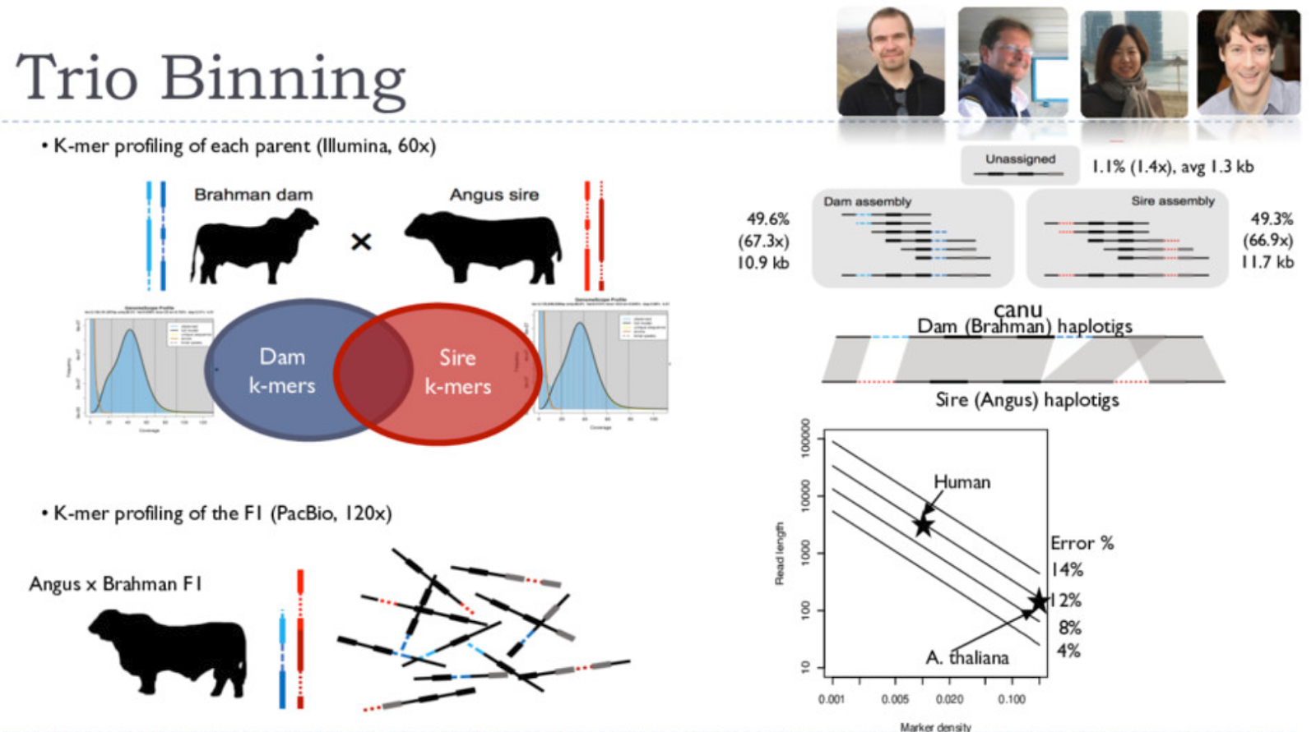
Diploid assembly
Notes:
Use Illumina short reads of parents to find maternal and paternal kmers.
Bin PacBio reads from offspring by their maternal and paternal kmers - assemble bins of pacbio reads individually.

Slide 28
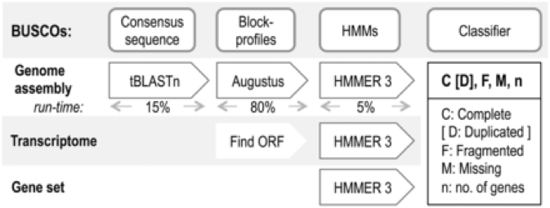
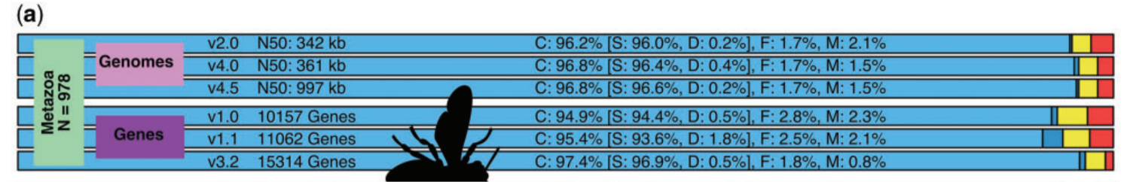
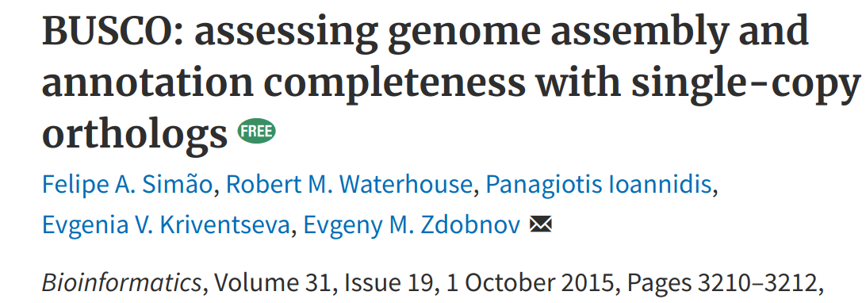
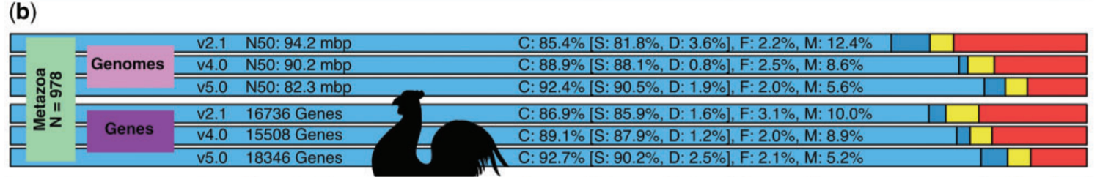
Genome assembly QC
Gene content
Order and orientation of genes/exons of known genes (e.g. housekeeping genes)
BUSCO: Quantitative assessment of genome assembly and annotation completeness based on evolutionarily informed expectations of gene content
Base Accuracy
Realign reads from the same species
Identify SNPs+indels. Indels - known to be enriched in Pacbio+Nanopore assemblies
k-mer completeness with respect to Illumina data (KAT)
Local structure accuracy
External evidence - e.g. sequencing data (REAPR, QUAST)
Known adjacencies, e.g. PCR primers or structural variants
Benchmarking Universal Single-Copy Orthologs
Start from set of conserved genes
Find them in the assembly
Assess whether they are Complete (C), Single copy (S) or Duplicated (D), Fragmented (F) or Missing (M)
Notes:
KAT - kmer analysis toolkit
BUSCO - Benchmarking Universal Single Copy Orthologs

Slide 29
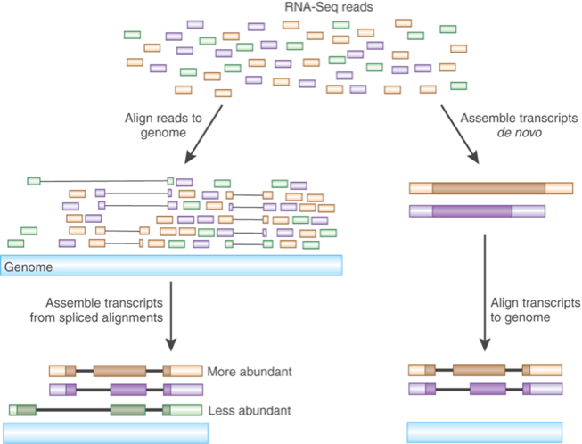
Metagenomic assembly
What if your DNA sample is a mix of uncultured (probably microbial) organisms?
Abundances of the different components vary
Need to separate divergent sequences from errors
Output is typically a set of contigs, with coverage
Still a valuable simplification of a data set
What scaffolding approaches are suitable?
Ayling M, Clark MD, Leggett RM. New approaches for metagenome assembly with short reads. Brief Bioinform. February 2019. doi:10.1093/bib/bbz020.
Transcriptome assembly
Another important form of data is cDNA from a sample
Again no single linear underlying sequence, and abundances of different components vary
Alternative splicing generates branches
Packages: Trinity, TopHat

Slide 30
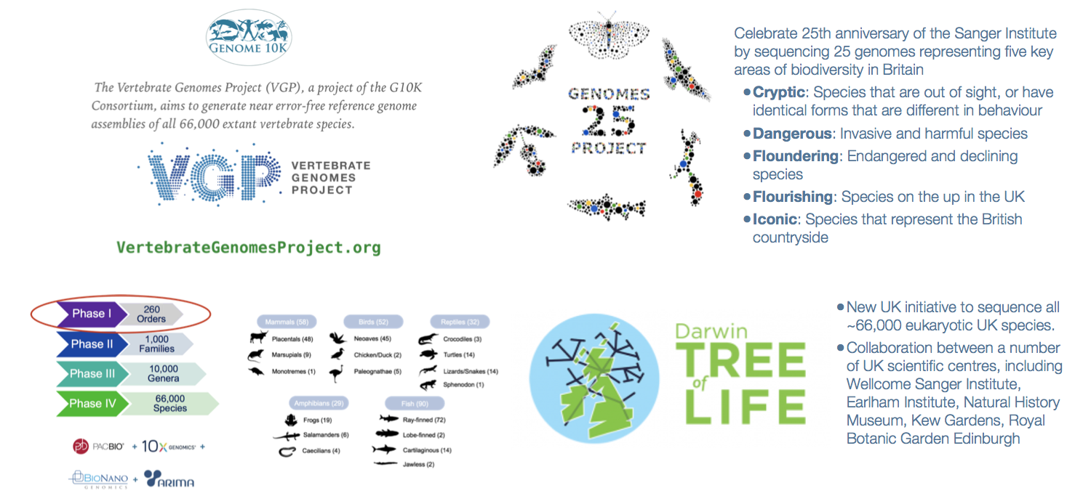
Tree of Life Project

Slide 31

Darwin Tree of Life Project

Slide 32
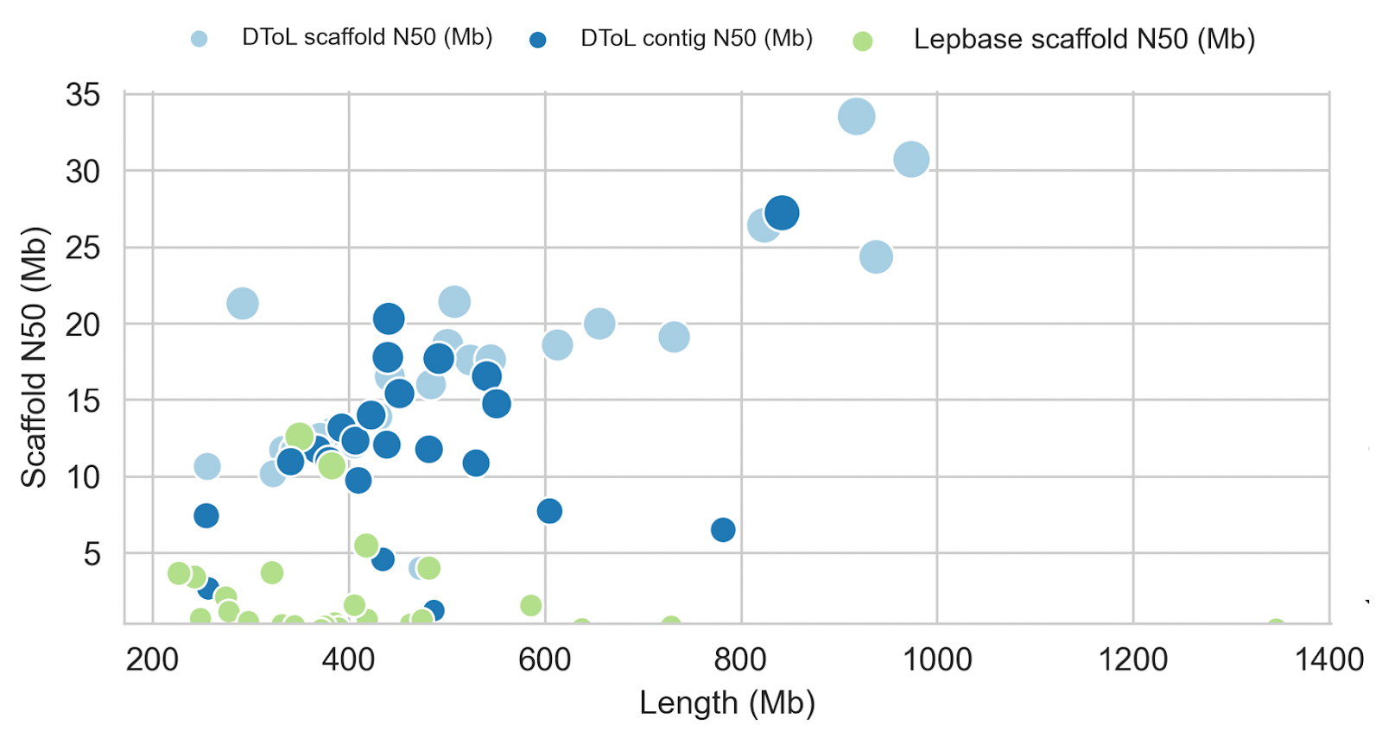
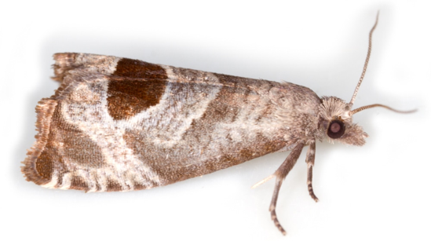

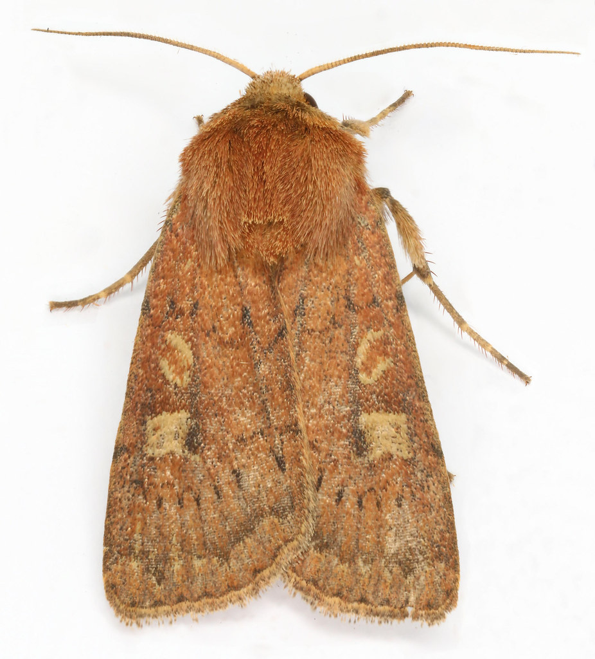
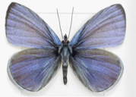
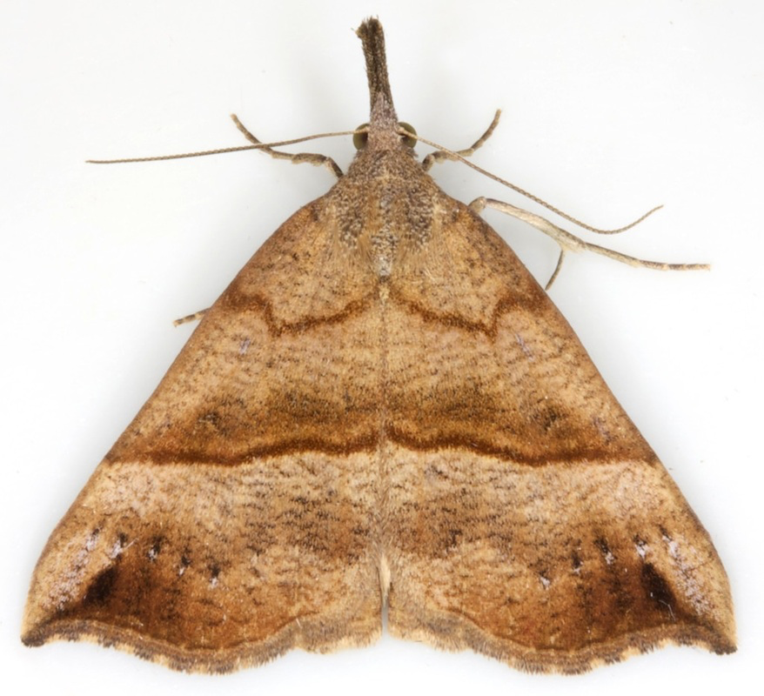
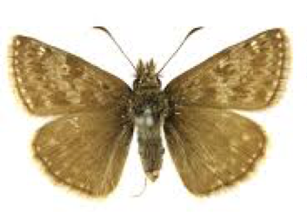
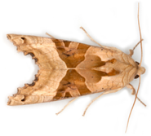









48 New Lepidoptera assemblies
Notes:
Lepidoptera - moths and butterflies
Assemblies generated are longer and have higher scaffold N50 than those in Lepbase

Slide 33
Complete chromosome contigs
Miga et al. Telomere-to-telomere assembly of a complete human X chromosome. Nature (2020).
Notes:
We’ve now assembled complete chromosomes (centromeres, telomeres and all) including for human genomes.

Slide 34
Complete chromosome contigs
Miga et al. Telomere-to-telomere assembly of a complete human X chromosome. Nature (2020).

Slide 35
Practical
Assembly of a Plasmodium falciparum (Malaria) chromosome
Basics of assembly algorithms
Assembly with PacBio (get to this quick it may take awhile!)
Assembly with with Illumina
Union (PacBio + Illumina) assembly and polishing
Assembly QC

